Slide 1
Multidimensional Linked List
Group Members
1.T Shivaprasad Nayak(181IT149)
2.Ashok Bhobhiya(181IT154)
3.Channamallikarjuna(181IT212)
4.Samarth S H(181IT240)

Slide 2
INTRODUCTION
Multi-dimension linked lists is a new data structure,which has powerful function and well visiting performance.
This data structure is mainly based on one dimensional linked list.
In this project we implementing 2D and 3D linked list, above order imagination is very difficult.

Slide 3
LITERATURE SURVEY
Paper Title and Authors | Work Done
Name-Create Multi-dimension Linked Lists on Recursive Algorithm and the Applications Authors-Chen Guangyi,He Zhaoyong | The Paper presents the Implementation of a new type of Data Structure called as Multi-dimension Linked Lists and their Applications.

Slide 4
Objective
Our objective is to implement 2D, 3D linked list using dynamic memory allocation and singly linked list concept.

Slide 5
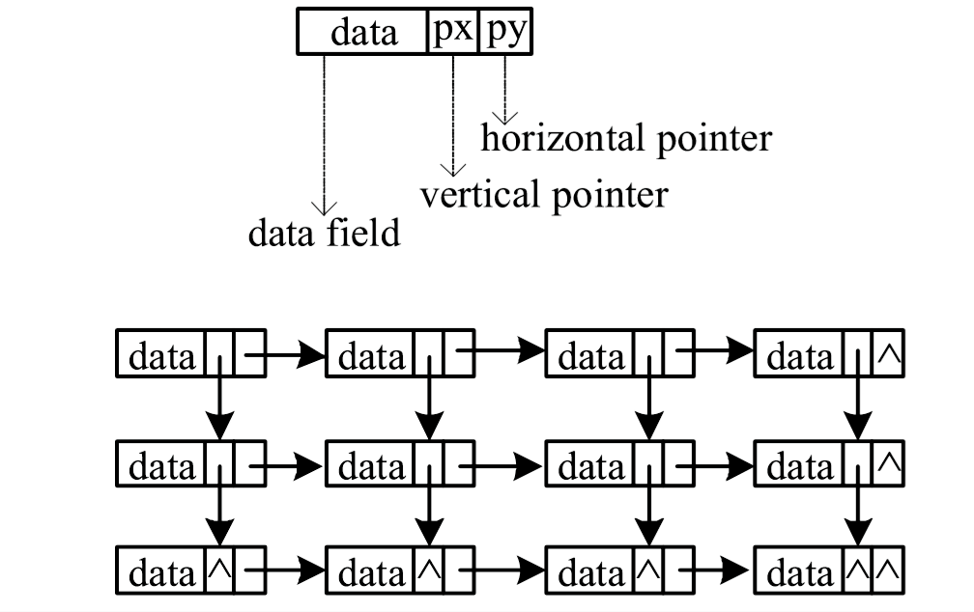
2 Dimensional linked list

Slide 6
Data | Px | Py
Insertion:
Horizontal pointer
Vertical pointer
Data field
1 | 2000 | 4000
2 | 3000 | 5000
3 | NULL | 6000
1000
2000
3000
4 | 5000 | 7000
5 | 6000 | 8000
6 | NULL | 9000
4000
5000
6000
7 | 8000 | NULL
8 | 9000 | NULL
9 | NULL | NULL
7000
8000
9000

Slide 7
Algorithm Steps for 2D linked list
Insert: Creating a new node, type of struct
Step-1: Make a root node
Step-2: Adding node in first row, put px=NULL for last node in a row
Step-3: updating row to next row (when no. of node in row=total no. of node in X direction)

Slide 8
Step-4: Inserting a node in 2nd row and onward
4.1- adding node at first column
similarly updating vertical pointer at above node
4.2- adding node other than 4.1 part

Slide 9
Traverse and Search:
Step-1: pickup root node go through all the link
Step-2: for search return a node with same element
Delete A node:
Step-1: Search given element
Step-2: put a blank space at given node location

Slide 10
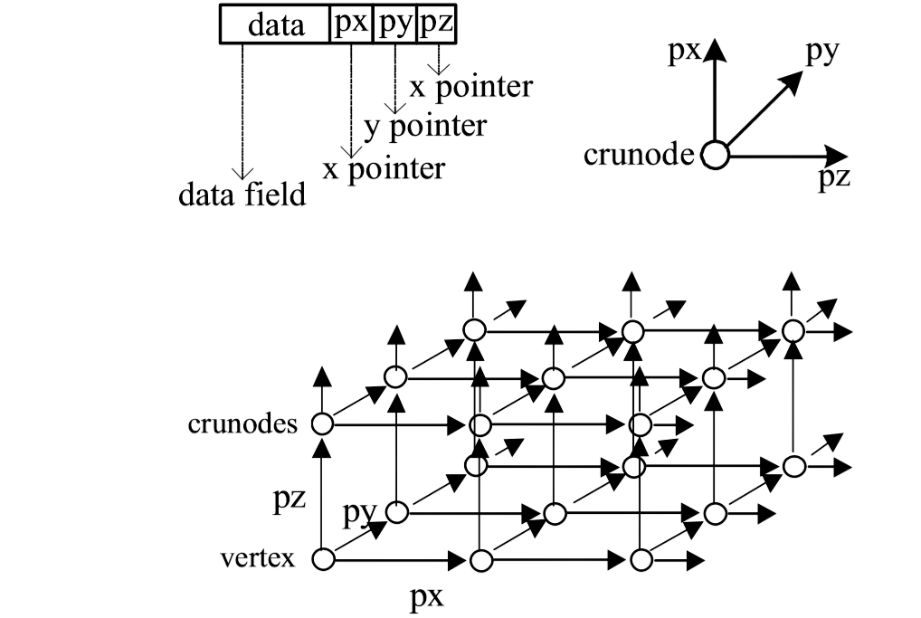
3 Dimensional linked list

Slide 11
Algorithm Steps for 3D linked list
Insertion: Creating a new node,of type struct
Step-1: Make a Root Node;
Any newly inserted node will be linked to xlink of the previous node until the length in x direction equals to given size of m;
Step-2:
After that any newly created node will be linked to its previous node by its ylink and again step 1 is performed until the length in y direction equals to given size of n;
Step-3:
After that any newly created node will be linked by z-link of its corresponding node and again step 2 is performed and the size of z-length is not fixed and it will be varying Dynamically.

Slide 12
Searching:
Step 1: A given element will be compared by one by one node in x-direction.
Step 2:A pointer will move to next line by the help of y-link of the first node in every line and Step 1 will be repeated.
Step 3:If it is not found in the nth level then with the help of z-link pointer will be moved to next level again Step 2 will be repeated.
Step 4:The Index of the value will be returned.
Deletion:
A Searching function will be called,and the node will be updated by a blank space.
Display:
It’s almost like Searching and the data of the node will be printed in different-different directions.

Slide 13
APPLICATIONS
Multi-dimensional linked lists have very important application in scientific computing, data structures,database and so on.
For example,the computer can apply the quick searching characteristic of multi-dimensional linked list to index data in database.

Slide 14
Advantages
The speed of database searches is very quick.Also, the time complexity of getting the data of N dimension linked lists is O(n^1/N).
Using multi-dimensional we can overcome the disadvantage of requiring multidimensional array EMS memory assignment is continuous.
Furthermore, multi-dimensional linked lists’ structure is simple,so we can apply this algorithm to realize complex data relation.
It’s very helpful for making a not complete matrix without wasting memory.

Slide 15
Summary
Time Complexity:
2 dimensional:
For insertion it will take constant time
Searching,traversing and delete all are in O(n)
3 dimensional:
Same as 2 dimensional

Slide 16
Conclusion
At present,multi-dimension linked lists mostly are used in the application based on rectangular coordinate system,so the multi-dimension linked lists is not more than three dimension in practice.
With the development of computer science, multi-dimension linked lists may be applied in other rectangular coordinate system spatial expression.

Slide 17
Reference
[1]. https://ieeexplore.ieee.org/document/4346954/
[2]. Thomas H. Cormen,Charles E. Leiserson,Ronald L.
Rivest, Clifford Stein “3rd Introduction to Algorithms”

Slide 18
Thank You

